Slide 1
Flights and Covid-19
Jeanie Wu, Pooja Mahajan, Robert Harvey, Ismael Rodriguez

Slide 2

Data Sources
Data on COVID-19 (coronavirus) by Our World in Data
(Data on COVID-19 (coronavirus) by Our World in Data)
Air Flight Data by Kaggle.com (author: Rajkumar Sengottuvel)
(Source website: https://www.kaggle.com/rajsengo/sfo-air-traffic-passenger-and-cargo-statistics?select=Air_Traffic_Passenger_Statistics.csv)

Slide 3
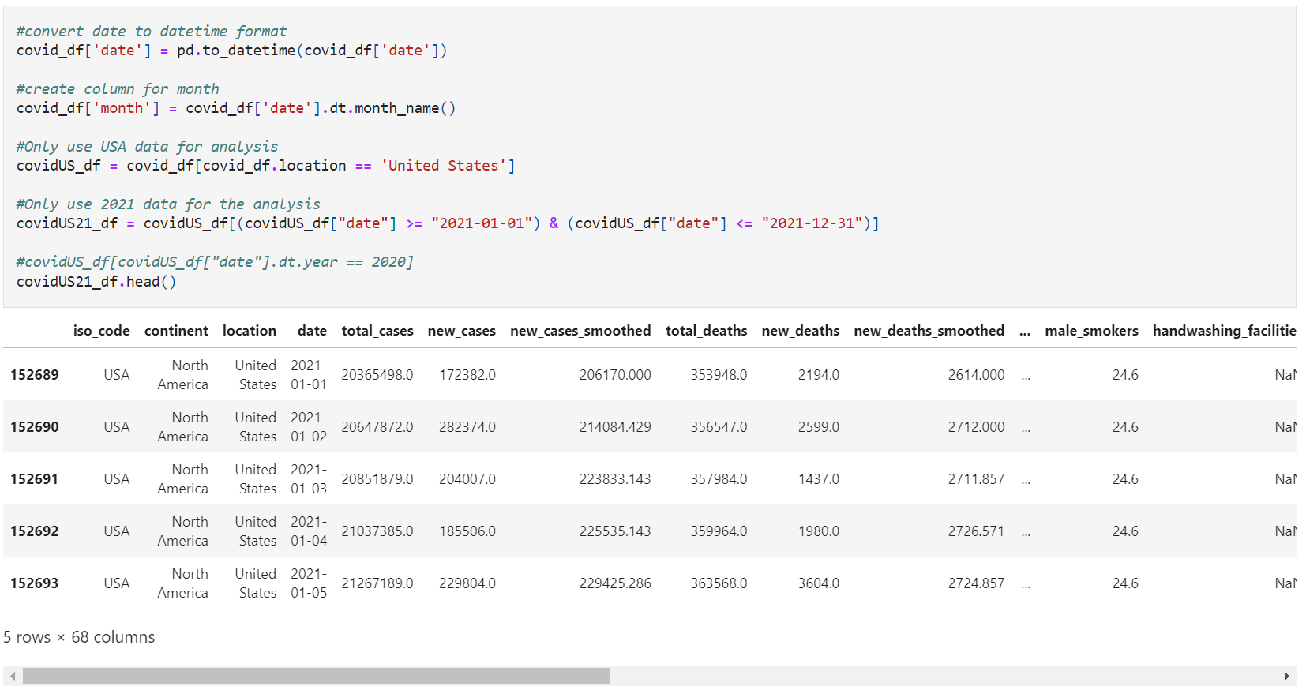
Exploratory Data Analysis - Covid

Slide 4
Covid-19 Pandemic - Analysis and Findings

Slide 5
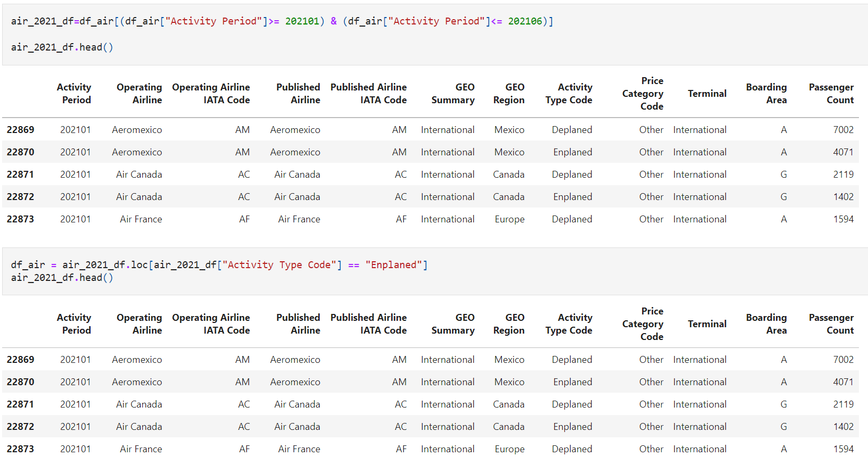
Exploratory Data Analysis – SFO Flights

Slide 6
SFO Flights - Analysis and Findings
Question 1: From 1/1/21-6/30/21, which months had the highest number of both domestic and international flights? Our hypothesis is the total number of passengers departing SFO per month would be evenly distributed across all (6) months

Slide 7
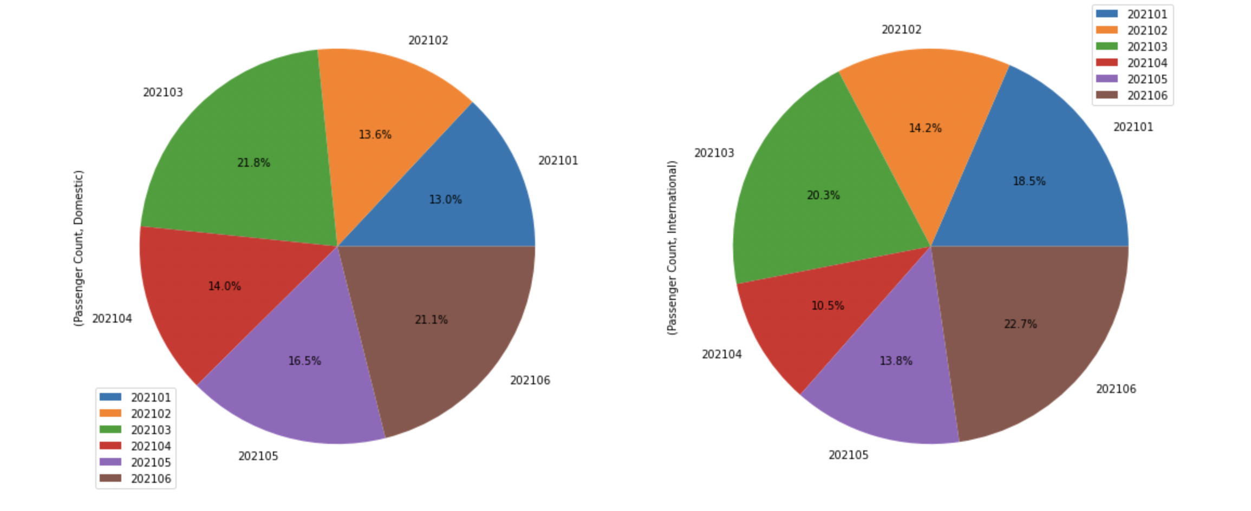
Results:
In June, we had the highest number of international flights
In March, we had the highest number of domestic flights

Slide 8
SFO Flights - Analysis and Findings
Question 2: What is the trend (if any) of the total number of domestic and international travelers departing SFO from 1/1/21-6/30/21, and did the total number of international departing passengers decrease because of flight restrictions made during those months?

Slide 9
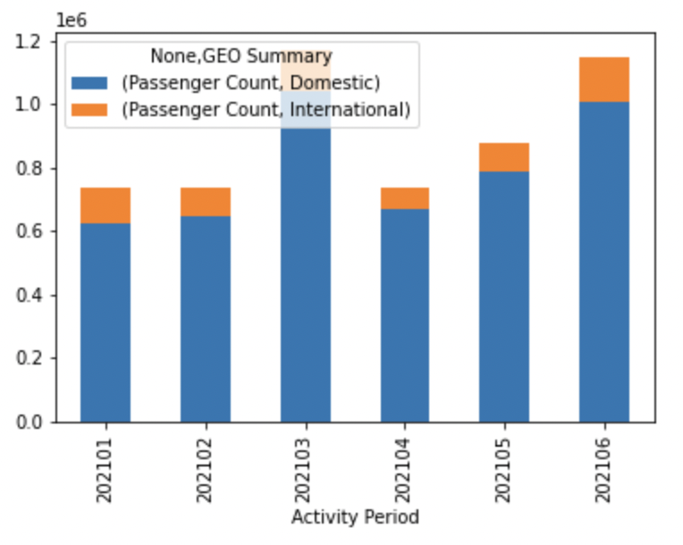
Results:
International flights have fewer passengers than domestic flights.
In April, the international flight decreased significantly

Slide 10
Covid 19 and SFO Flight Data – Analysis and Findings
Question: what’s the relationship between SFO departing flights and covid-19 (if any)?

Slide 11
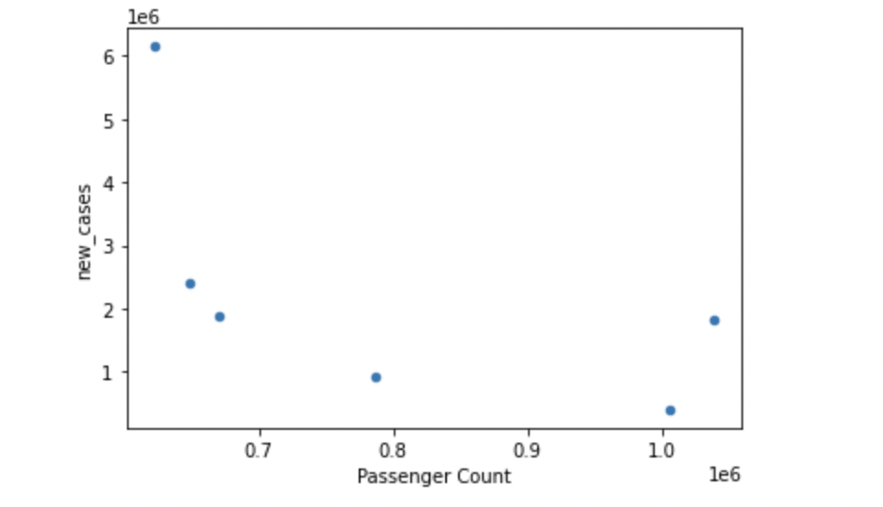
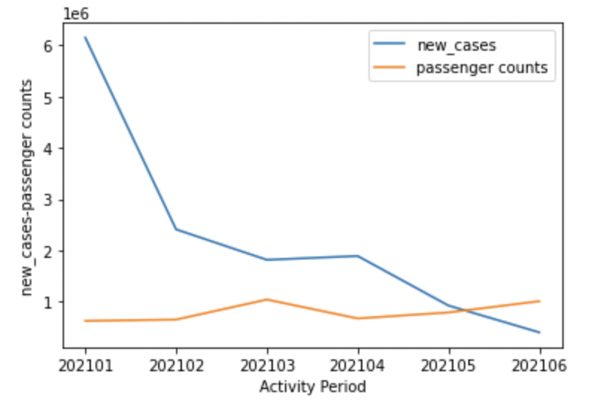
Covid & SFO Flights
The new cases decreased in 2021 from January to June, and the number of passengers flying started increasing at this time.
In May, SFO departing flights exceeded new cases of Covid (when adjusted to match the flight data ).

Slide 12
Data Limitations
We found that our original dataset was limited in that we only have data from one airport, SFO.
Our dataset was also limited by 6 months of flight data, from January to June 2021.
The data counts/numbers do not match evenly when compared apples to apples, so we adjusted the Covid data to match the SFO flight data in order to plot them together

Slide 13
Q&A

